Slide 1
miRNA interactions
The animated “movie”
Based on “A network-biology perspective of microRNA function and dysfunction in cancer” by
Cameron P. Bracken, Hamish S. Scott and Gregory J. Goodall

Slide 2
miR-Y
miR-B
miR-G
miR-R1

Slide 3
RISC

Slide 4
Features of miRNA-regulated networks
Posttranscriptional modifications are changes that occur to a newly transcribed primary RNA transcript (hnRNA) after transcription has occurred and prior to its translation into a protein product
Transcription is the process of making an RNA copy of a gene's DNA sequence

Slide 5
Conveniently for the study of miRNA function, most targets show evidence of depleted mRNA levels, and mRNA destabilization is the dominant effect of mi RNAs by the time that substantial target repression occurs

Slide 6
However, in the vast majority of cases, the magnitude of miRNA-directed mRNA depletion is mild

Slide 7

How is it then possible that such crucial regulators of cellular processes seem to have such modest effects on most of their targets?

Slide 8
However, in the vast majority of cases, the magnitude of miRNA-directed mRNA depletion is mild

Slide 9
If targets are enriched for genes whose prod-ucts participate in common signalling pathways,
then the sum of typically modest interactions can facilitate a stronger response than might be achieved through the direct regulation of any one gene in isolation

Slide 10


regulation of distinct sub-networks.
The simultaneous targeting of multiple genes may also facilitate more specific fine-tuning through the regulation of distinct sub-networks

Slide 11
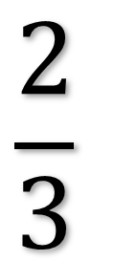
Polycistrons as cooperative functional units
$$\frac{2}{3}$$
polycistronic clusters
Promoter
DNA
Promoter
About two-thirds of mi RNAs are encoded in polycistronic clusters

Slide 12
Polycistrons as cooperative functional units
$$\frac{2}{3}$$
polycistronic clusters
Promoter
DNA
TF
Promoter
About two-thirds of mi RNAs are encoded in polycistronic clusters

Slide 13
Polycistrons as cooperative functional units
$$\frac{2}{3}$$
polycistronic clusters
Promoter
RNA
TF
Y’all go 2gether
RNA Polymerase
About two-thirds of mi RNAs are encoded in polycistronic clusters

Slide 14
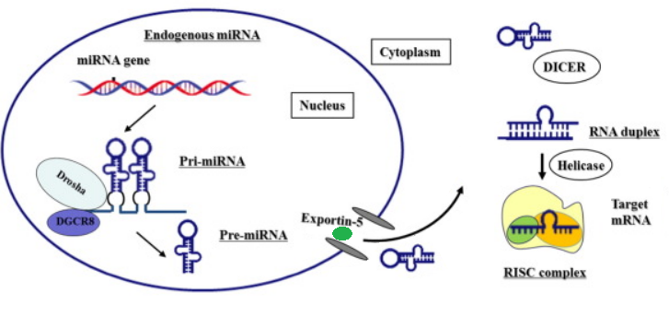

Slide 17
mi RNAs in polycistrons should therefore be regarded as cooperative functional units, and their actions should be considered collectively

Slide 18
Such co- regulated mi RNAs expressed from the same cluster have a tendency to target the same gene

Slide 19
Dominant regulatory roles of network hubs

Slide 21
. It is useful to identify nodes with atypically high numbers of connections (‘hubs’) because these represent sites of signalling convergence with potentially large explanatory power for network behaviour or utility for clinical prognosis and therapy

Slide 22

Hub mRNAs tend to possess longer than average 3′ untranslated regions (3′ UTRs) with a higher than average density of target sites
5’
AAAAAAAAA
5’UTR
3’UTR

Slide 23


Conversely, ‘housekeeping’ and highly expressed tissue-specific genes typically have low densities of target sites for co-expressed miRNAs and are therefore less subject to direct miRNA-mediated suppression

Slide 24
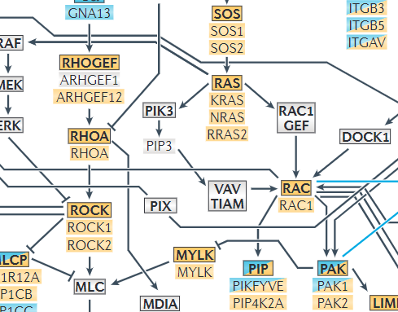
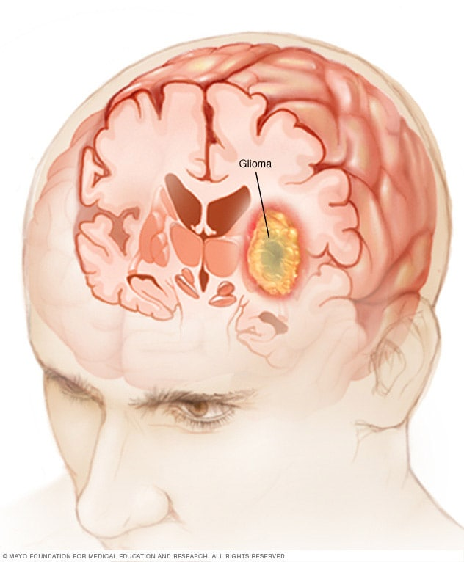
a relatively small number of miRNA nodes could account for the majority of network connections, an observation that was not explicable simply by differences in the sizes of the predicted target gene sets between miRNAs
Similarly, 21 hub miRNAs were predicted to target 70% of the genes that are differentially expressed between grade II and grade III–IV gliomas

Slide 25
Challenges in understanding miRNA function

Slide 26
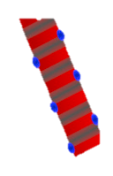
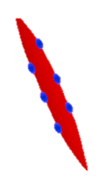
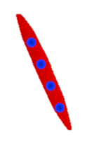

If the targets of a given miRNA are enriched in a biological process or pathway, then it is reasonable to infer that the regulating miRNA is involved in that process

Slide 27
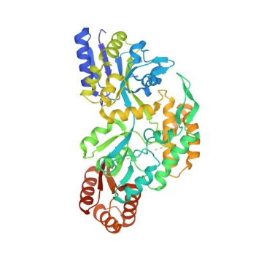

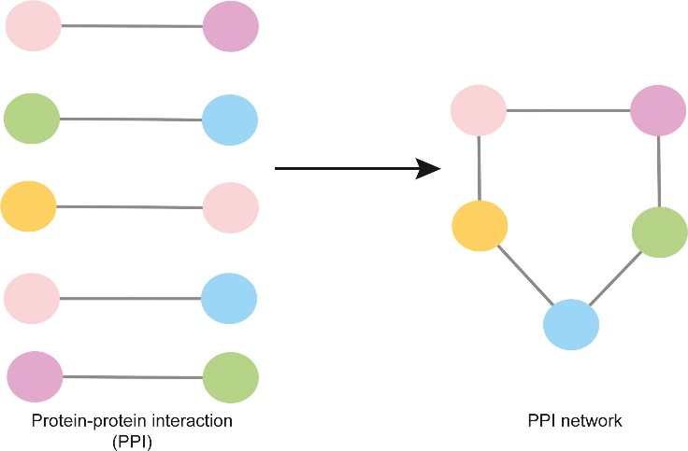
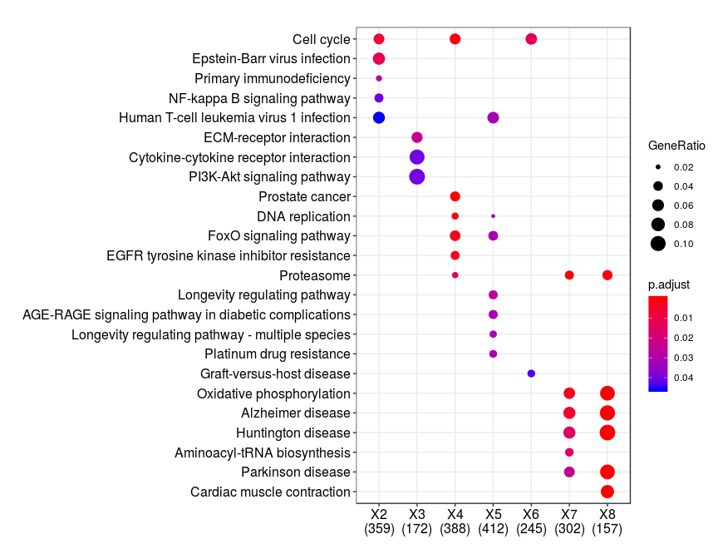

Lists of target genes can then be examined collectively in the contexts of KEGG pathways, protein–protein interaction networks and enrichment analysis for common gene ontology terms

Slide 28
The participation of miRNAs in extensively connected genetic networks provides a challenge to understanding their function, because if the level of evidence required to establish miRNA–target relationships is set too low, genuine interactions become obscured by noise

Slide 29
Accuracy of target prediction

Slide 30
Accurate prediction is hampered by the inability to effectively model secondary structures in RNA that preclude miRNA– target interaction, the influence of RNA binding proteins on target-site accessibility and the effect of competition between potential binding sites
It is made even more difficult by the occasional and unpredictable tolerance of mismatches in the seed region, as well as the potential for non-seed interaction through central and 3′ pairing

Slide 31
Indirect effects

Slide 32
miRNAs act on their direct targets at the levels of both transcript stability and translational suppression, but can also initiate indirect effects on gene expression through the downstream activities of miRNA-targeted transcription factors.
5’
AAAAAAAAA
5’UTR
3’UTR

Slide 33
Context-dependent effects.

Slide 34
The same miRNA can have different, or even opposite, functional outcomes in different contexts.
miR-200 can also either promote or inhibit metastasis, depending on the cell model used

Slide 35
The influence of competitive endogenous RNAs

Slide 36
The effectiveness of a miRNA relies on there being sufficient copies of the miRNA within the cell to bind all its targets.

Slide 37
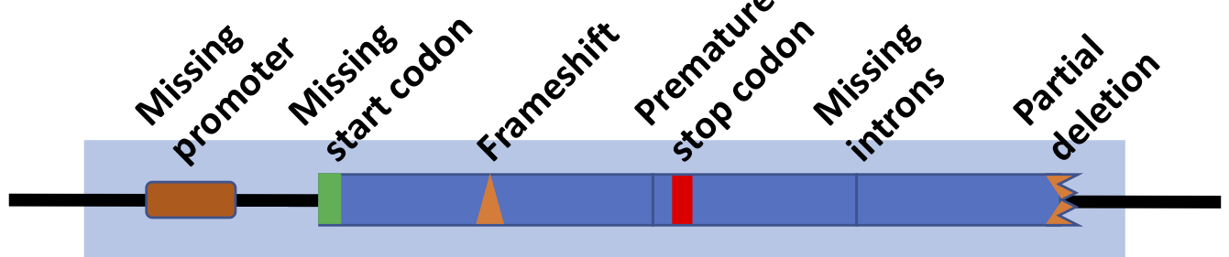

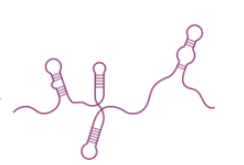
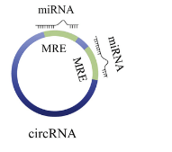
miRNA function can potentially be affected by the number and affinity of targets in the transcriptome and the ‘sponging’ activities of specific pseudogenes, long non-coding RNAs, circular RNAs and transcripts of protein-coding genes65that have high miRNA-binding capacity

Slide 38
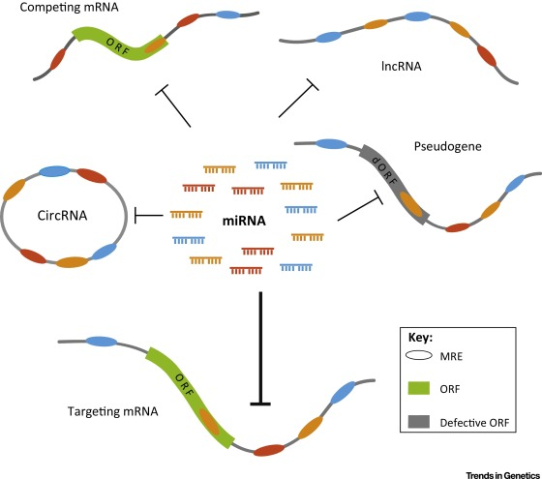
Susceptibility to competition by ceRNAs may mostly be limited to mi RNAs that are at relatively low abundance, but might become influential even for abundant miRNAs in some scenarios, such as gene amplification of a target.

Slide 39
miRNA–transcription factor co-regulation

Slide 40
complex interplay exists between the two largest classes of transcriptional and post-transcriptional regulators — transcription factors and miRNAs
TF

Slide 41

predicted miRNA targets were enriched for transcriptional regulators
transcriptional regulation
many miRNA target hubs in genetic networks are themselves transcription factors
TF

Slide 42
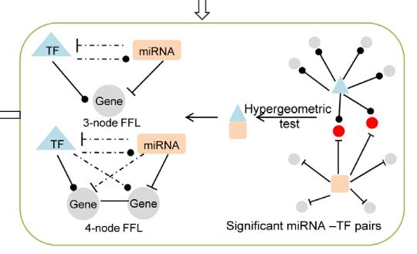
Furthermore, reciprocal feedback loops in which a miRNA and transcription factor co-regulate the expression of one another constitute a recurring network motif that occurs more often than predicted by chance
TF

Slide 43

In incoherent feedforward loops, the miRNA and transcription factor carry out opposing functions, which enables precise modulation of gene expression to reduce noise and confer stability
TF

Slide 44
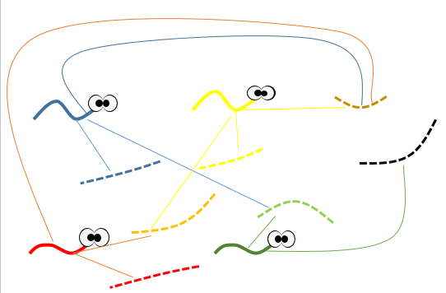
Genes encoding transcription factors that are highly connected in the overall gene network tend to regulate miRNAs more extensively than they regulate other genes, and are themselves more likely than other genes to be regulated by these same miRNAs
TF

Slide 45
mi RNAs are also more likely to regulate a pair of transcription factors if the transcription factors physically interact
TF
TF
TF
TF
high-throughput transcriptomic data can be combined with known or predicted interactions between miRNAs, transcription factors and target genes, thereby uncovering regulatory networks in a way that would not be possible through the consideration of individual targets in isolation

Slide 46
the influence of miRNAs is mediated not just directly through their primary targets but also indirectly through the action of the transcription factors they regulate
TF

Slide 47
When comparing the profiles of wild-type and Dicer-knockout fibroblasts (which are consequently depleted of most mi RNAs), it was found that, as expected, the direct targets that were identified by HITS–CLIP were regulated post-transcriptionally. However, most of the overall gene expression changes after miRNA pertur-bation occurred at the level of transcription, with these changes being greater in both number and magnitude than post-transcriptional changes2
The propagation of signal through transcription-factor interactions also provides further explanation as to how mi RNAs can have a major impact on cell behaviour, yet only modestly regulate most of their direct targets

Slide 48

Concluding remarks
This are actually just mine

Slide 49
To take in account
To use
To consider
miRNA
Kegg network
Protein – protein interaction
Expression profiles
Transcriptor factor
Polycistronic miRNAs
I do have cycles: TF – Gene – miRNA
Frequency of interaction in the EP
The amount of the different elements matter… A LOT, I cannot use it as binary

Slide 50
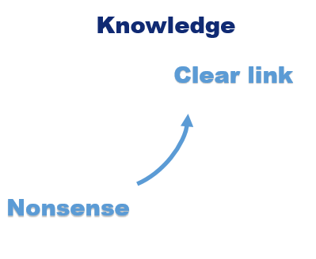
My plan next week (or two)
Goal: Have the prototype by September
Learn how KEGG applies their network (luckily Cytoscape and Kegg use XML)
Define how I am going to present them
Select / construct the “Big network”
Get the datasets of EP in muscle and feed the network edges (more ahead)
Remove “smallest” edges
Review results.
If satisfactory, tune data for the artifact thingy by knowledge.
Else, back to white board

Slide 51
My future plan
Add Transcriptor factors interaction (Define a distinction on nodes as TF)
Consider seeds
Consider coordinate in the sequence
Consider competition

Slide 52
Get the datasets of EP in muscle and feed the network edges
First time ever with expression profile
Hadn’t use GEO before
Probably need to apply enrichment that I don’t know to do neither
Define threshold for consider a link (maybe just presence/absence at this point?)
Literature review for each dataset may be essential.
Gibran helps me normally with this stuff

